Slide 1
DOCUMENT ANALYSIS
FP-GROWTH
ASSOCIATION
RULES
FREQ. ITEMSET MAPPING
ONTOLOGY
ASSOCIATION RULES DATABASE
Figura 1
DOCUMENT ANALYSIS BLOCK
Tokenize
Transform Cases
(lower cases)
Filter
Stopwords
Generate
n-gams (n≤3)
Filter Tokens
(4-50)
Stemming (Snowball)
Figura 2

Slide 2
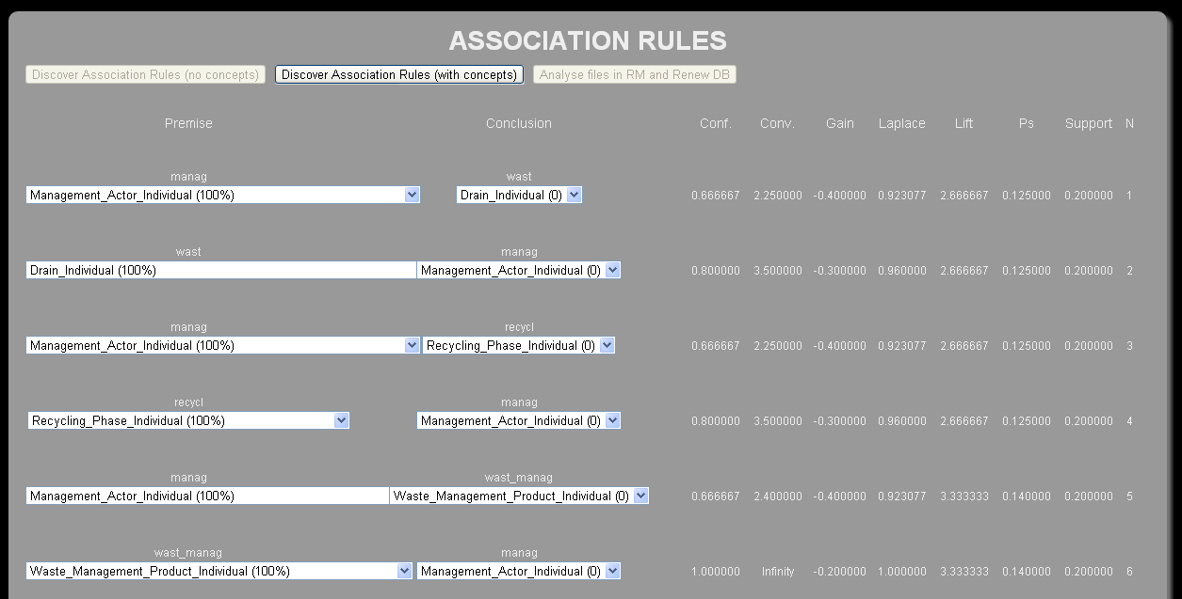
Figura 4

Slide 3
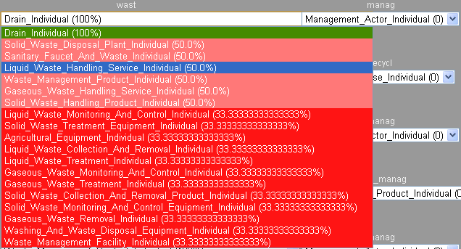
Figura 3

Slide 4
Figura 5

